Slide 1



HOW DO CHARTERS IMPACT A COMMUNITY?

Slide 2

HOW DO CHARTERS IMPACT A COMMUNITY?
They are the community!

Slide 3
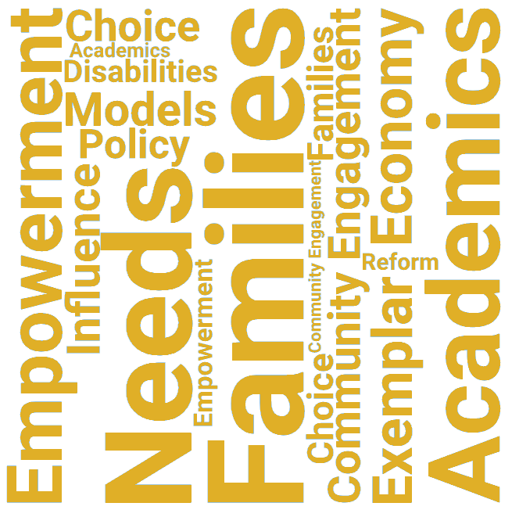
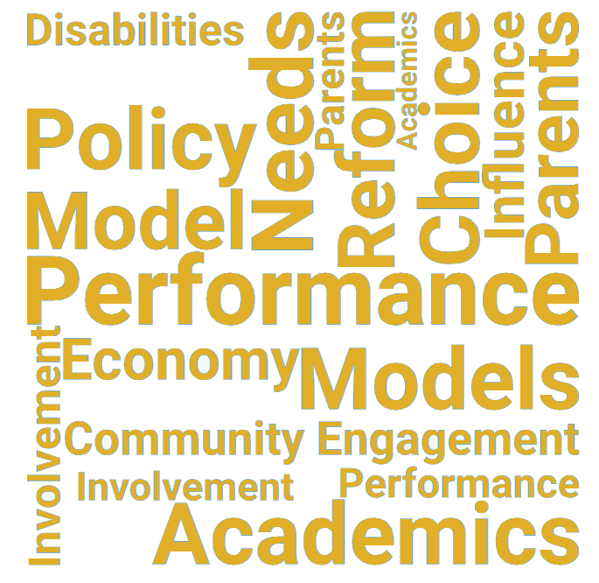


Charters Provide Community Benefits
3
Notes:
Although charter schools are public schools, they are uniquely poised to provide several unique benefits to a community that district-run schools do not.

Slide 4
IMPROVED ACADEMIC PERFORMANCE
High academic standards can lead to improved educational outcomes and an elevated level of education within a community.
Notes:
Improved Academic Performance: Charter schools often strive for high academic standards and innovative teaching methods, leading to improved educational outcomes for students. This can raise the overall level of education in the community and provide parents with additional options for their children's schooling.

Slide 5
CHOICE & PARENTAL INVOLVEMENT
School choice empowers parents and families and encourages more active involvement in their student’s educational community.
Notes:
Choice and Parental Involvement: Charter schools provide parents with another choice in education, allowing them to select a school that aligns more closely with their child's needs and educational philosophy. This can increase parental involvement in their child's education and empower families to take an active role in school governance and decision-making.

Slide 6
COMMUNITY ENGAGEMENT
Charter schools foster strong community ties and partnerships, which can lead to enriching educational opportunities for students.
Notes:
Community Engagement: Charter schools often foster strong community ties and partnerships. They may collaborate with local businesses, community organizations, and universities to provide unique educational opportunities, internships, and resources for students, thereby enriching the community as a whole.

Slide 7
ADDRESSING SPECIFIC NEEDS
Charters have the freedom to serve specific student populations or offer unique school models which, in turn, strengthens a community’s educational landscape.
Notes:
Addressing Specific Needs: Some charter schools are designed to serve specific populations or address particular educational challenges. For example, there are charter schools focused on STEM education, arts integration, bilingual education, or serving students with high needs. By catering to these specific needs, charter schools can fill gaps that traditional public schools may struggle to address adequately.

Slide 8
ECONOMIC IMPACT
High quality charter schools attract families which increases property values and stimulates the local economy.
Notes:
Economic Impact: High-quality charter schools can contribute to the local economy by attracting families to the area who are seeking better educational opportunities for their children. This can lead to increased property values and stimulate local businesses.

Slide 9
INFLUENCE ON POLICY & PRACTICE
Successful charter schools can serve as a model for educational reform and innovation within a community.
Notes:
Influence on Policy and Practice: Successful charter schools often become models for educational reform and innovation. They may influence policies at the district or state level, prompting changes in curriculum, teacher training, and school management practices.

Slide 10

Made Possible by Sponsors
Approved by the Missouri State Board of Education, sponsors make charter schools possible.
Reach out to MCPSC to learn more about becoming a sponsor.
10
Notes:
These benefits are made possible by sponsors, through their charter school application and oversight practices. When implemented with fidelity under a high-quality sponsor, well-run charter schools have the potential to positively influence academic achievement, parental involvement, community engagement, and educational innovation within a community.

Slide 11

THANK YOU
Name
Phone
Email
URL

