Slide 1
Missouri School Improvement Program
Continuous Improvement
Cycle 2
February 27, 2025

Slide 2
2
Agenda
Overview of Continuous School Improvement
Continuous School Improvement – Cycle 2
  Review of the Pilot Process
  Timeline and Implementation
  Continuous Improvement Validation Requirements
  CSIP Implementation Rubric
  Climate and Culture Verification
  Annual Performance Report (APR)Points
Charter School Cycle 2 Placement
Questions/Comments
*Information within this presentation may be edited prior to the finalization of the Comprehensive Guide.

Slide 3
Overview of Continuous Improvement

Slide 4
4
Cycle 2 – Continuous School Improvement Requirements
Continuous Improvement requirements will continue to be 30% of the Annual Performance Report (APR).
School Improvement Planning
CSIP/CSIP Summary
CSIP Implementation Rubric
Success-Ready Students
School Entry Readiness
Individual Career and Academic Plan (ICAP)
Required Documentation
Annual Audit Report
Annual Secretary of the Board Report
CSIP Implementation Responses
Priorities for Continuous Improvement
Climate and Culture Survey
Attendance
Required MOSIS & Core Data
Collections

Slide 5
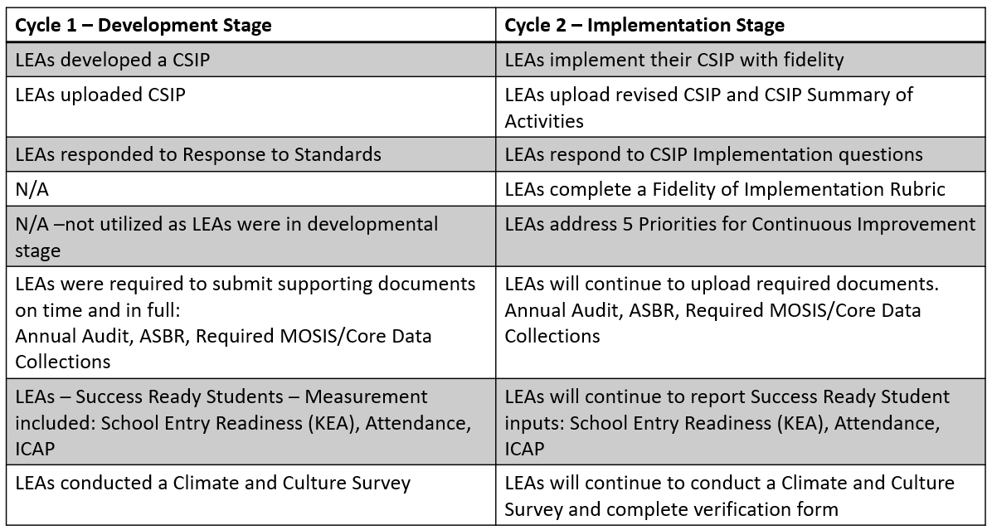
5
Cycle 1 vs. Cycle 2 Comparison

Slide 6
Continuous School Improvement
Cycle 2

Slide 7
Review of Pilot Process
18 LEAs participated in the pilot process
Pilot timeframe: September – December
LEAs were provided with expectations in 4 areas:
  CSIP
  CSIP Fidelity of Implementation Rubric
  Priorities for Continuous Improvement
  Implementation Responses
LEAs were also provided with suggested upload documents and an upload format

Slide 8
Review of Pilot Process
Area Supervisors worked with LEA leaders throughout the process to refine expectations and to develop an alternate upload format.
Pilot LEAs participated in a survey at the completion of the process and participated in a follow-up Webex, as a final review of the process.
Information about the Pilot work was shared with the MSIP Advisory Committee (MAC).

Slide 9
Timeline and Implementation
LEAs were placed into two rounds and notified in September 2024.
Feedback regarding reviews will be provided by Area Supervisors after each round.
Round | Start Date | Due Date | Review Period
1 | August 1, 2025 | December 31, 2025 | January 1 – March 1, 2026
2 | August 1, 2026 | December 31, 2026 | January 1 – March 1, 2027

Slide 10
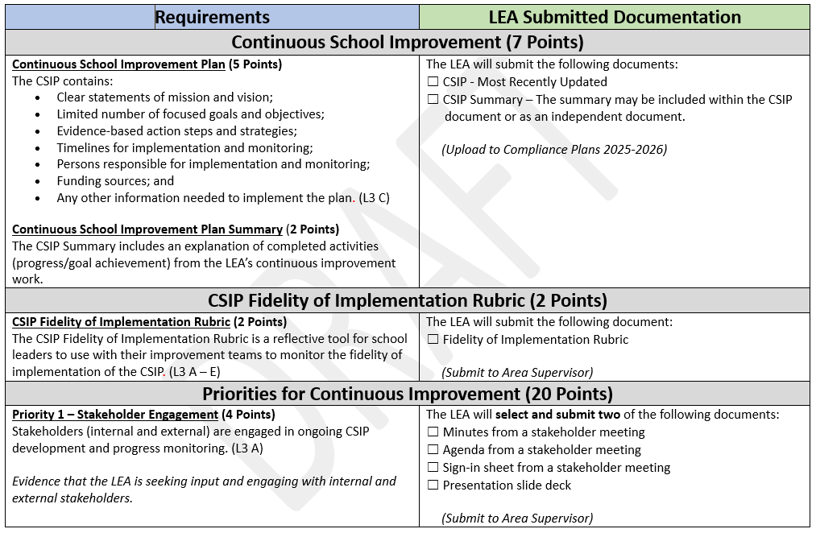
Cycle 2 CI Validation Requirements

Slide 11
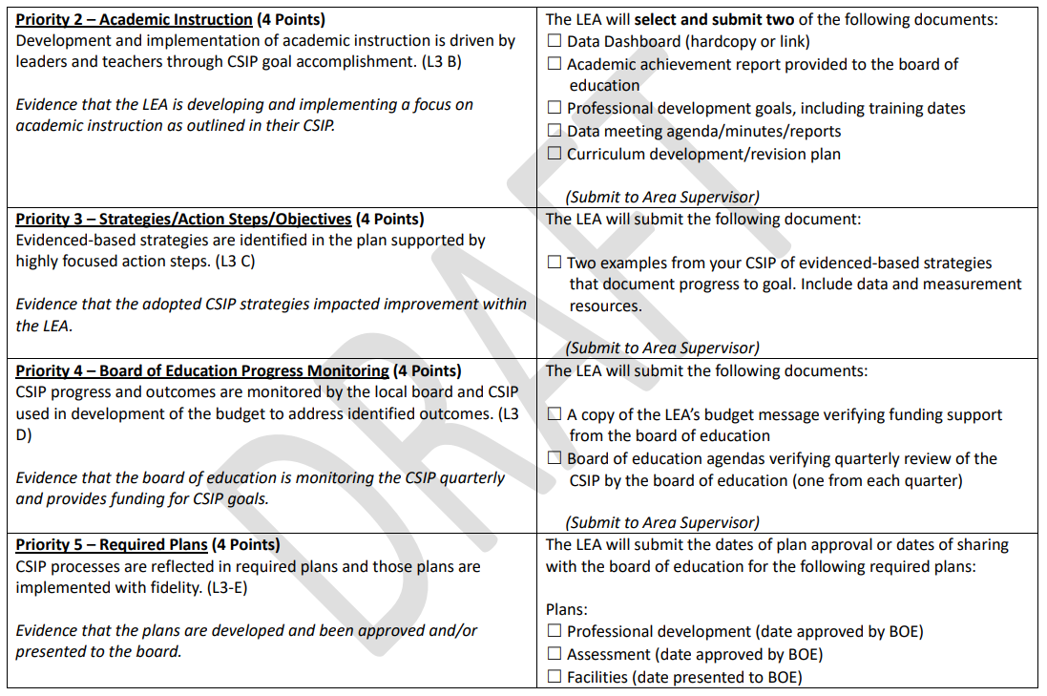
Cycle 2 CI Validation Requirements

Slide 12
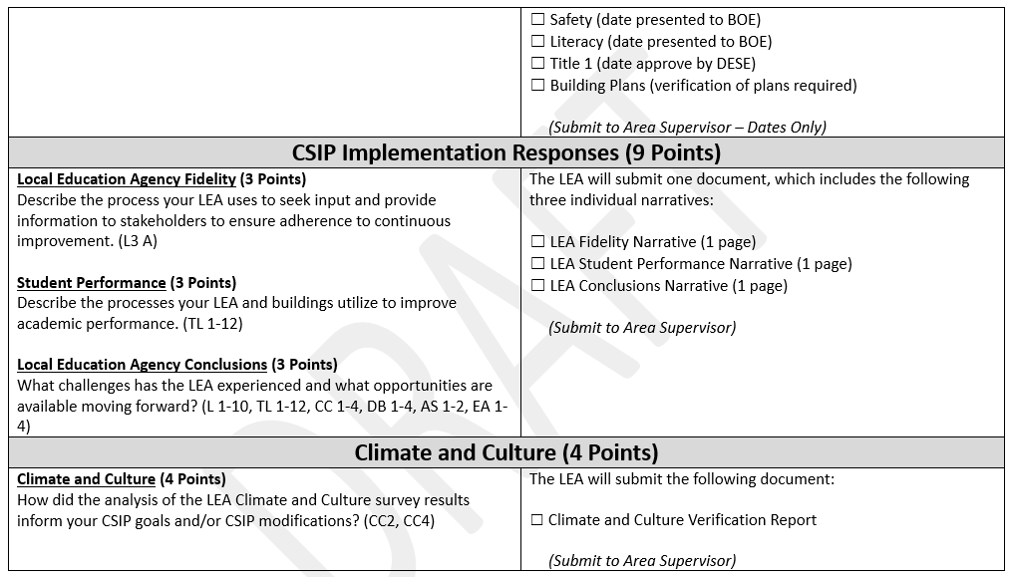
Cycle 2 CI Validation Requirements

Slide 13
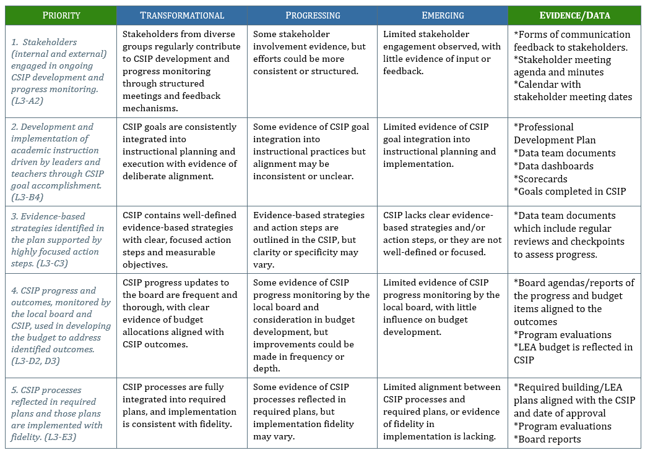
CSIP Fidelity of Implementation Rubric

Slide 14
Climate and Culture Survey Verification
LEAs must administer at least one Climate and Culture Survey every two years. The survey must include the following essential indicators:
  The school system assures student voices are heard and respected (older student, parent and staff).
  The school system provides school culture and climate data and reports periodically to all stakeholders (parent and staff).
  Educator teams address positive classroom learning environment (staff).

Slide 15
Climate and Culture Survey Verification
Required components of the Climate and Culture Verification Report include:
  Identification of the date and type of survey administered.
  Identification of all groups surveyed and numbers of respondents within those groups.
  Identification and brief explanation of how the LEA’s climate and culture work has impacted the CSIP.

Slide 16
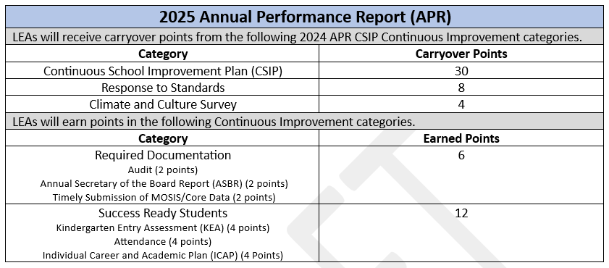
Annual Performance Report (APR) Points

Slide 17
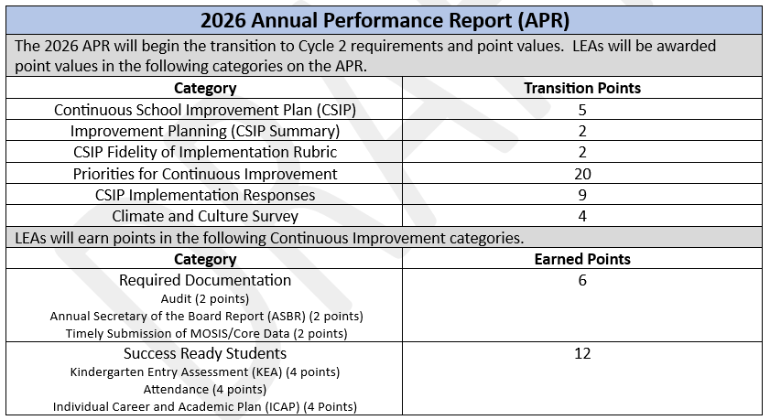
Annual Performance Report (APR) Points

Slide 18
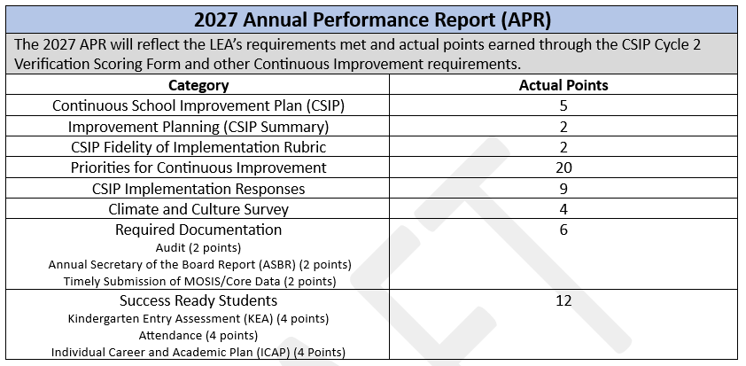
Annual Performance Report (APR) Points

Slide 19
Charter School Cycle 2 Placement

Slide 20
Cycle 2 – LEA Placement
Cycle 2 Continuous Improvement Reviews
Round 1 |  | Round 2
Kansas City Area | St. Louis Area | Kansas City Area | St Louis Area
Allen Village | Gateway Science | Academy for the Integrated Arts | City Carden Montessori
 | Lift for Life Academy | Citizens of the World | Kairos
 | Leadership School - Normandy | Crossroads Charter | Momentum Academy
 | Atlas | Ewing Marion Kauffman School | The Biome
 | St. Louis Voices | Gordon Parks Elementary | Lafayette Preparatory School
 | Believe Academy | Guadalupe Centers Schools | Northside Community School
 | Confluence Academies | Hogan Preparatory Academy | St. Louis Language Immersion School
 | Kipp St. Louis | Hope Leadership Academy
 | Premier Charter | KC International Academy
 | The Soulard School | Kipp Endeavor Academy
 |  | Scuola Vita Nuova
 |  | Brookside
 |  | DeLaSalle
 |  | Genesis
 |  | Hope Leadership
 |  | Lee A. Tolbert
 |  | KC Girls Prep Academy

Slide 21
Questions/Comments

Slide 22
22
Missouri Department of Elementary and Secondary Education
The Department of Elementary and Secondary Education does not discriminate on the basis of race, color, religion, sex, sexual orientation, national origin, age, veteran status, mental or physical disability, or any other basis prohibited by statute in its programs and activities. Inquiries related to department programs and to the location of services, activities, and facilities that are accessible by persons with disabilities may be directed to the Jefferson State Office Building, Director of Civil Rights Compliance and MOA Coordinator (Title VI/Title VII/Title IX/504/ADA/ADAAA/Age Act/GINA/USDA Title VI), 7th Floor, 205 Jefferson Street, P.O. Box 480, Jefferson City, MO 65102-0480; telephone number 573-522-1775 or TTY 800-735-2966; fax number 573-522-4883; email civilrights@dese.mo.gov.

